Slide 1
ABC Call Volume Trend Analysis
Tanushri Asthana

Slide 2
PROJECT DESCRIPTION
In this project, you'll be diving into the world of Customer Experience (CX) analytics, specifically focusing on In this project, you'll be diving into the world of Customer Experience (CX) analytics, specifically focusing on the inbound calling team of a company. You'll be provided with a dataset that spans 23 days and includes various details such as the agent's In this project, you'll be diving into the world of Customer Experience (CX) analytics, specifically focusing on the inbound calling team of a company. You'll be provided with a dataset that spans 23 days and includes various details such as the agent's name and ID, the queue time (how long a customer had to wait before connecting with an agent), the time of the call, the duration of the call, and the call status (whether it was abandoned, answered, or transferred). A Customer Experience (CX) team plays a crucial role in a company. They analyze customer feedback and data, derive insights from it, and share these insights with the rest of the organization. This team is responsible for a wide range of tasks, including managing customer experience programs, handling internal communications, mapping customer journeys, and managing customer data, among others. In the current era, several AI-powered tools are being used to enhance customer experience. These include Interactive Voice Response (IVR), Robotic Process Automation (RPA), Predictive Analytics, and Intelligent Routing. One of the key roles in a CX team is that of the customer service representative, also known as a call center agent. These agents handle various types of support, including email, inbound, outbound, and social media support. Inbound customer support, which is the focus of this project, involves handling incoming calls from existing or prospective customers. The goal is to attract, engage, and delight customers, turning them into loyal advocates for the business.
name and ID, the queue time (how long a customer had to wait before connecting with an agent), the time of the call, the duration of the call, and the call status (whether it was abandoned, answered, or transferred). A Customer Experience (CX) team plays a crucial role in a company. They analyze customer feedback and data, derive insights from it, and share these insights with the rest of the organization. This team is responsible for a wide range of tasks, including managing customer experience programs, handling internal communications, mapping customer journeys, and managing customer data, among others. In the current era, several AI-powered tools are being used to enhance customer experience. These include Interactive Voice Response (IVR), Robotic Process Automation (RPA), Predictive Analytics, and Intelligent Routing. One of the key roles in a CX team is that of the customer service representative, also known as a call center agent. These agents handle various types of support, including email, inbound, outbound, and social media support. Inbound customer support, which is the focus of this project, involves handling incoming calls from existing or prospective customers. The goal is to attracalling team of a company. You'll be provided with a dataset that spans 23 days and includes various details such as the agent's name and ID, the queue time (how long a customer had to wait before connecting with an agent), the time of the call, the duration of the call, and the call status (whether it was abandoned, answered, or transferred). A Customer Experience (CX) team plays a crucial role in a company. They analyze customer feedback and data, derive insights from it, and share these insights with the rest of the organization. This team is responsible for a wide range of tasks, including managing customer experience programs, handling internal communications, mapping customer journeys, and managing customer data, among others. In the current era, several AI-powered tools are being used to enhance customer experience. These include Interactive Voice Response (IVR), Robotic Process Automation (RPA), Predictive Analytics, and Intelligent Routing. One of the key roles in a CX team is that of the customer service representative, also known as a call center agent. These agents handle various types of support, including email, inbound, outbound, and social media support. Inbound customer support, which is the focus of this project, involves handling incoming calls from existing or prospective customers. The goal is to attract, engage, and delight customers, turning them into loyal advocates for the business.

Slide 3
Business Understanding:
Advertising is a crucial aspect of any business. It helps increase sales and makes the audience aware of the company's products or services. The first impressions of a business are often formed through its advertising efforts. The target audience for businesses can be local, regional, national, or international. Various types of advertising are used to reach these audiences, including online directories, trade and technical press, radio, cinema, outdoor advertising, and national papers, magazines, and TV. The advertising business is highly competitive, with many players bidding large amounts of money to target the same audience segment. This is where the company's analytical skills come into play. The goal is to identify those media platforms that can convert audiences into customers at a low cost. In this project, you'll be using your analytical skills to understand the trends in the call volume of the CX team and derive valuable insights from it.

Slide 4
Tasks
What is the average duration of calls for each time bucket?
Can you create a chart or graph that shows the number of calls received in each time bucket?
What is the minimum number of agents required in each time bucket to reduce the abandon rate to 10%?
Propose a manpower plan for each time bucket throughout the day, keeping the maximum abandon rate at 10%.

Slide 5
Assumption:
Assumption to be taken…
An agent works for 6 days a week; On average, each agent takes 4 unplanned leaves per month; An agent's total working hours are 9 hours, out of which 1.5 hours are spent on lunch and snacks in the office. On average, an agent spends 60% of their total actual working hours (i.e., 60% of 7.5 hours) on calls with customers/users. The total number of days in a month is 30.

Slide 6
Tech Stack Used:
Ms Excel: Helps in to gather , clean , removing duplicates and analyze data.
PowerPoint : Enables to present the findings in a clear and compelling manner.

Slide 7
APPROACH
Data cleaning
Data analysis
Data visualization

Slide 8
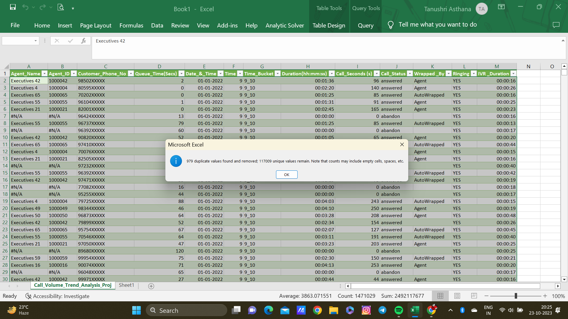
Data cleaning
Remove duplicates.

Slide 9
Task 1:
Average Call Duration: Determine the average duration of all incoming calls received by agents. This should be calculated for each time bucket.
Your Task: What is the average duration of calls for each time bucket?
Insight: Highest Average of Call Seconds is 203.41 sec within time bucket 19_20.
It means mostly calls were made answered in between 19:00 PM – 20:00 PM.
Lowest Average of Call Seconds is 203.41 sec within time bucket 12_13.
It means mostly calls were made answered in between 12:00 PM – 13:00 PM.

Slide 10
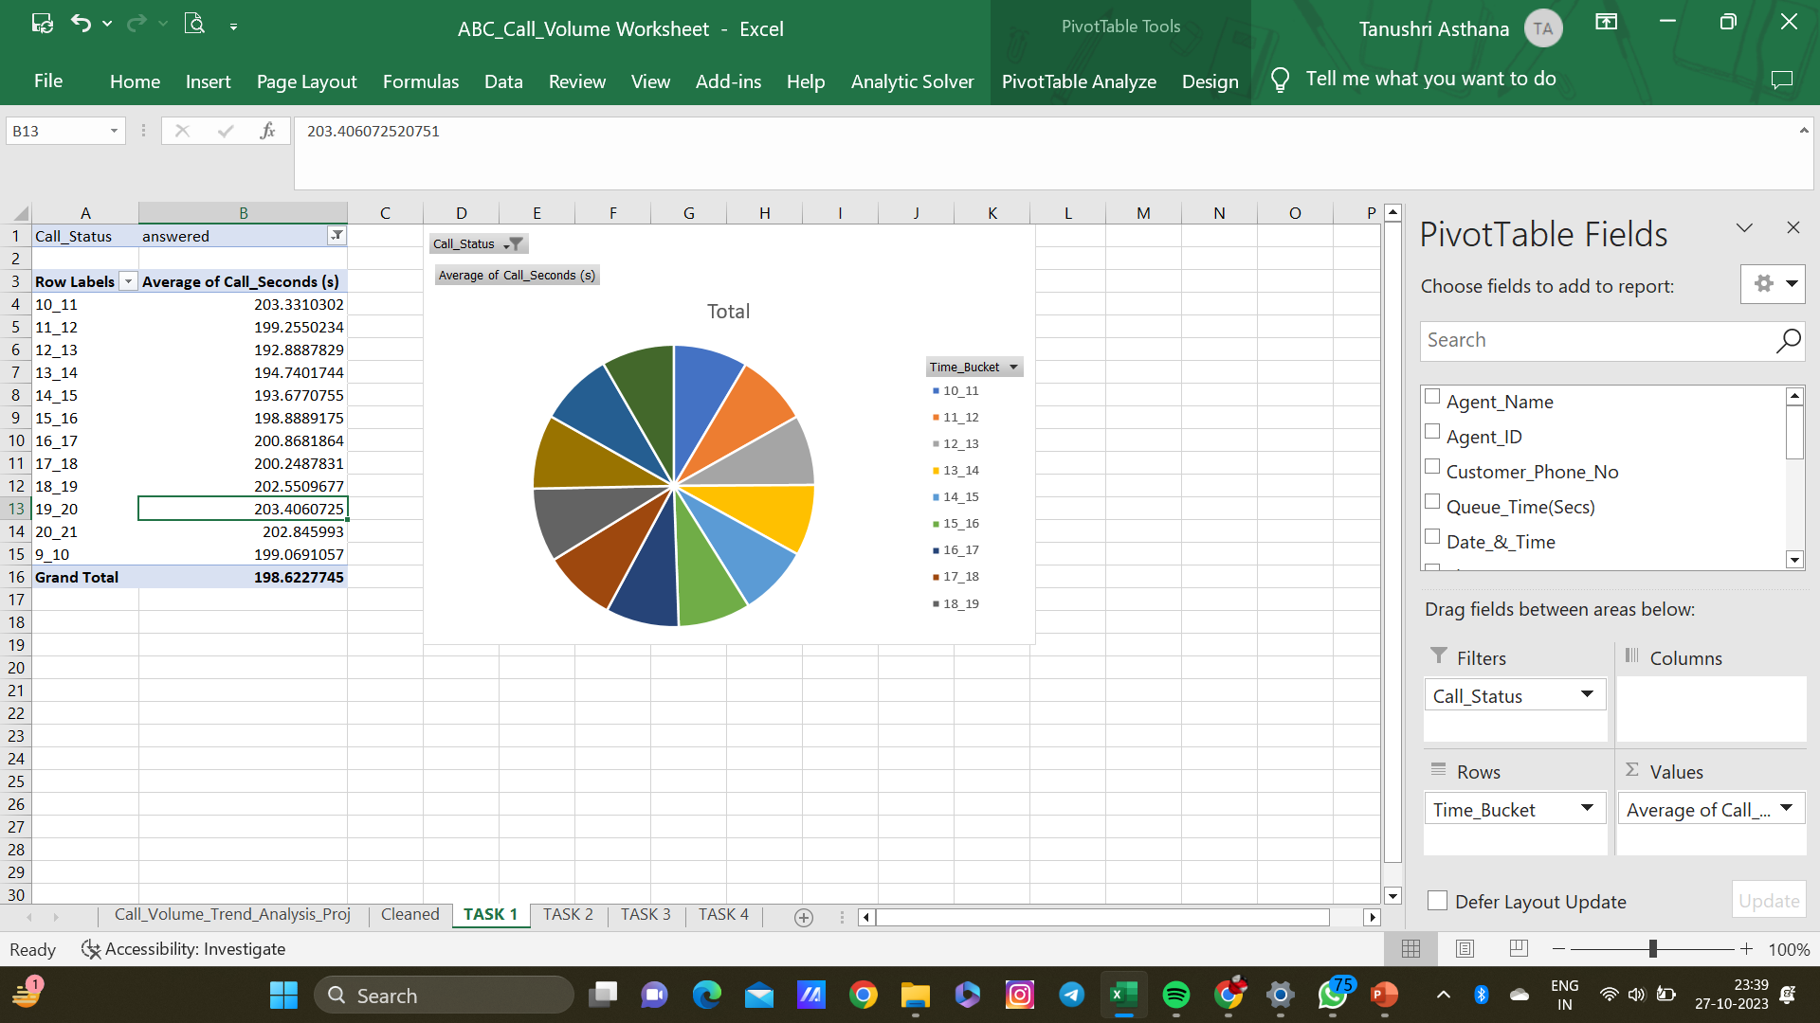

Slide 11
Task 2
Call Volume Analysis: Visualize the total number of calls received. This should be represented as a graph or chart showing the number of calls against time. Time should be represented in buckets (e.g., 1-2, 2-3, etc.).
Your Task: Can you create a chart or graph that shows the number of calls received in each time bucket?
Insight: From the above bar plot we can infer that time bucket 11_12 i.e. 11AM to 12PM has the highest count for total number incoming calls i.e. 14431.

Slide 12
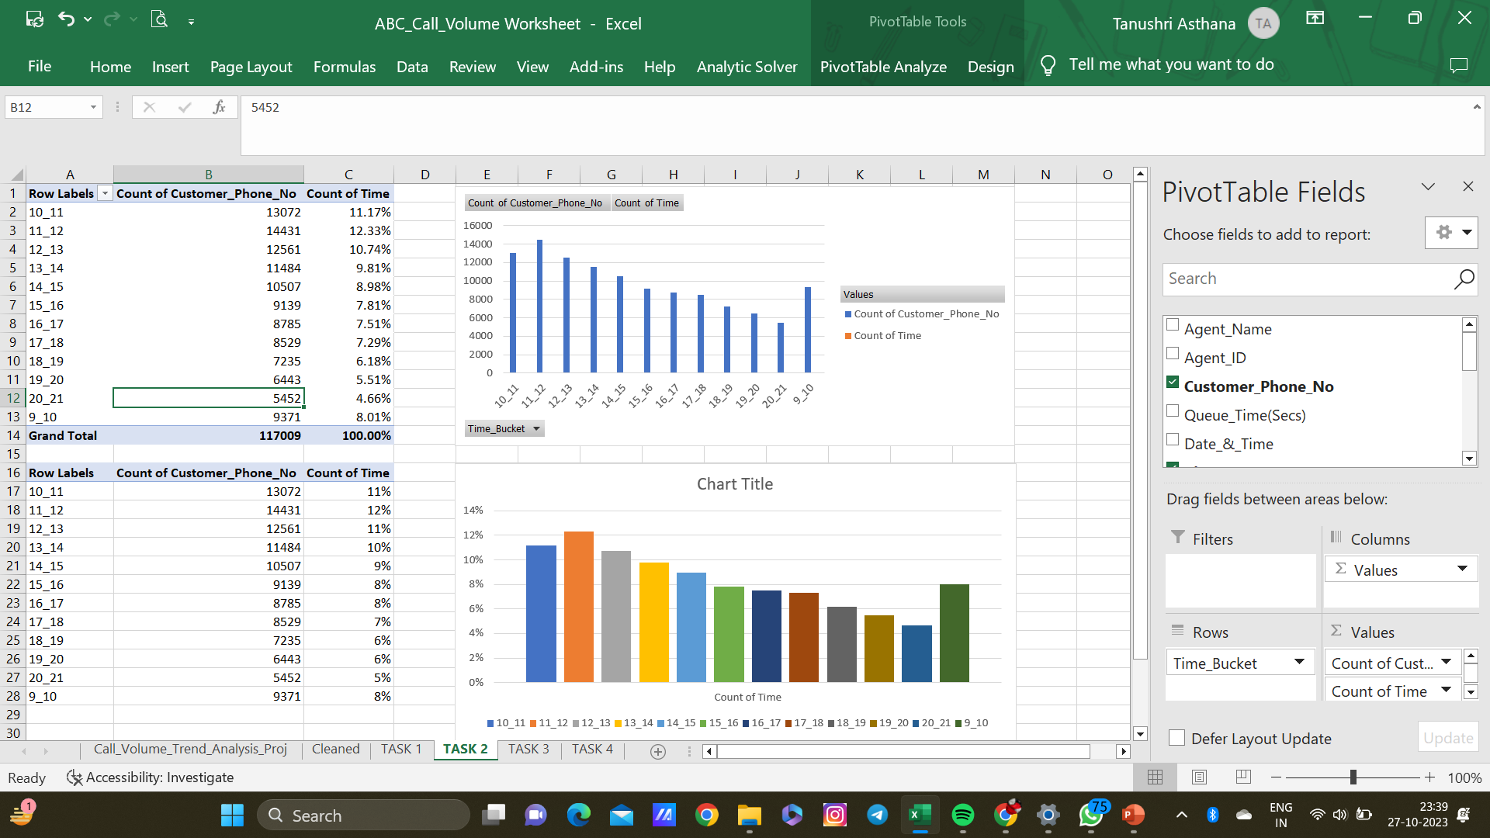

Slide 13
Task 3:
Manpower Planning: The current rate of abandoned calls is approximately 30%. Propose a plan for manpower allocation during each time bucket (from 9 am to 9 pm) to reduce the abandon rate to 10%. In other words, you need to calculate the minimum number of agents required in each time bucket to ensure that at least 90 out of 100 calls are answered.
Your Task: What is the minimum number of agents required in each time bucket to reduce the abandon rate to 10%?
Insight: 54 is the minimum number of agents required in each time bucket to reduce the abandon rate to 10%?

Slide 14
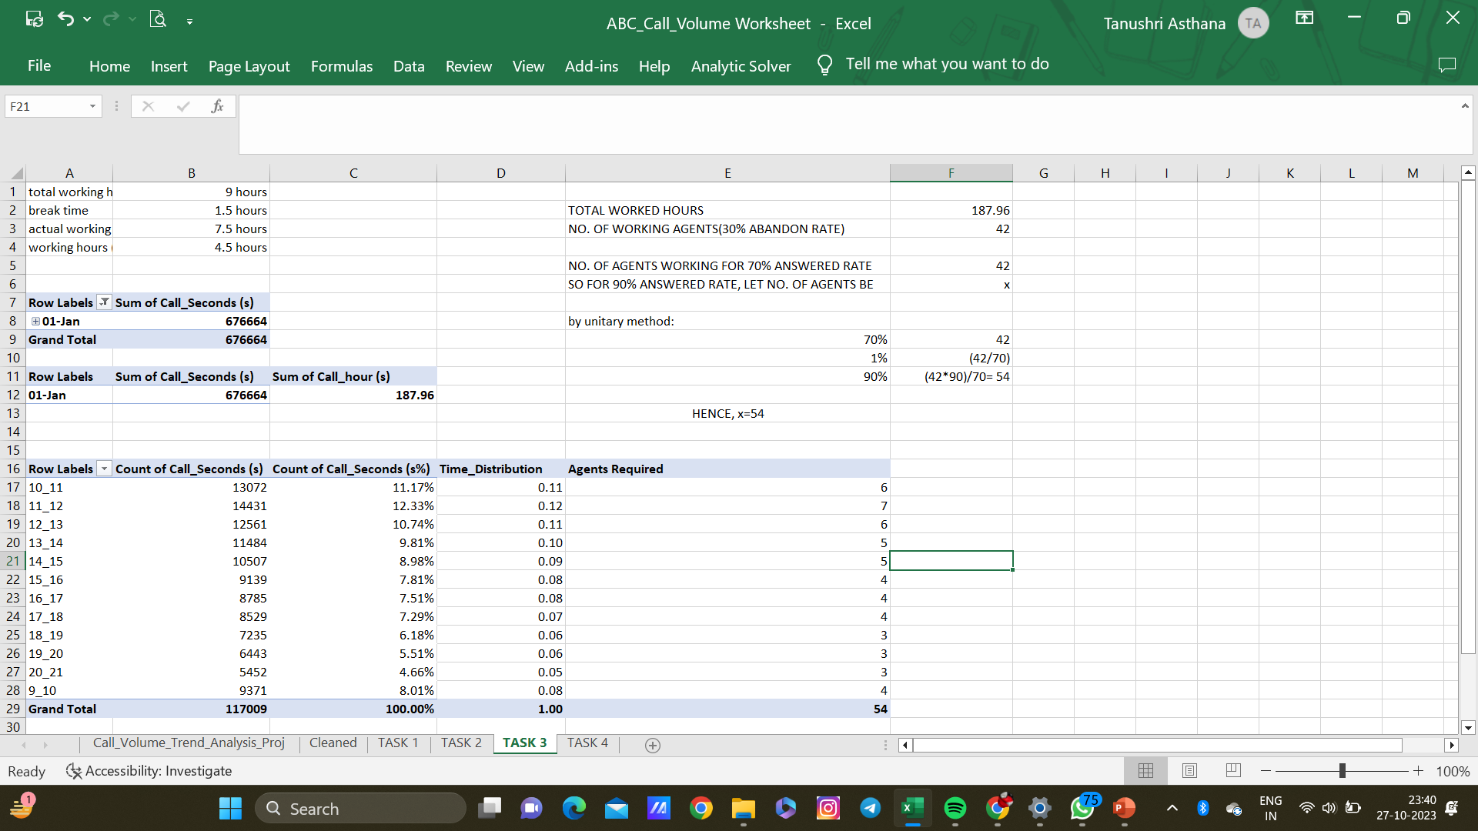

Slide 15
Task 4:
Propose a manpower plan for each time bucket throughout the day, keeping the maximum abandon rate at 10%.
Insight: 17 agents are required to reduce the abandon rate at 10%.

Slide 16
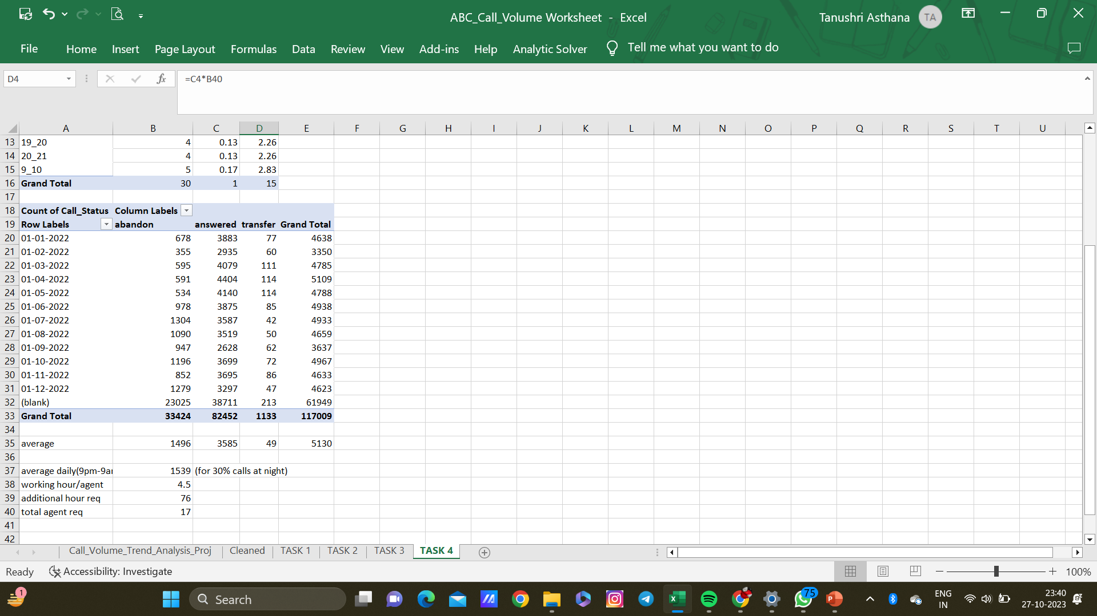

Slide 17
Conclusion:
Thus we have derived the insights for the company and understood the trends in the calling (Call center) Company

Slide 18
Result:
Throughout this project, I have gained valuable insights into the impact of an analyst in the customer service department. It is evident that a company strives to ensure maximum customer satisfaction through effective customer-handling strategies.
One of the notable tools used is the Interactive Voice Response (IVR) system, which employs AI technology to address customer queries by identifying their specific concerns and routing the calls to the appropriate agents for resolution.
The analysis of the provided data was made easier by the pre-calculated time buckets and call duration converted into seconds, saving time and effort in calculations.

Slide 19
THANKYOU ☺
https://docs.google.com/spreadsheets/d/1oR9Nznlf3huZXoL5Ru_ToYC8Yu1aFD9r/edit?usp=drive_link&ouid=116264600853168329913&rtpof=true&sd=true
FOR EXCEL WORKSHEET CLICK ON ABOVE LINK.

